Slide 1
Intro to Cryptography
Unit 5.1
Cybersecurity Boot Camp |

Slide 2
Today’s Goals
By the end of class, you will be able to:
Articulate the goals of cryptography: privacy, authentication, integrity, and non-repudiation.
Discuss modern encryption standards, and in particular AES.
Compare and contrast substitution and transposition ciphers.
Explain how textual data can be represented in binary, octal, and hex.
Determine the output of the XOR operation given two input bitstreams.
Compare and contrast symmetric and asymmetric cryptography.
Use OpenSSL to encrypt data with a symmetric key.
Notes:
Review goals; address any questions.

Slide 3
Why Cryptography Matters
Threat Actors
Sender
Receiver
Secured Channel with Data Exchange
Fundamentally, information is often the most prized asset of individuals and organizations alike.
Ensuring information can be stored, transmitted, and received securely (in avoidance of prying eyes) is often a key responsibility of the modern security professional.

Slide 4
Goals of Cryptography
Privacy
Authenticity
Integrity
Non-repudiation

Slide 5
Goals of Cryptography
Privacy
Authenticity
Integrity
Non-repudiation
Encryption
Digital Signatures
Hashes
Signatures and
Certificates

Slide 6
Activity: Key Terms and Orientation (15 min)
In this activity, you will familiarize yourself with some key terms in cryptography.
Instructions:
Open the file which contains key terms in cryptography
Use the Cryptography Terminology Resource and Wikipedia to define and give examples of these key terms

Slide 7
Key Terms and Orientation
Instructor Review

Slide 8
Today’s Goals
By the end of class, you will be able to:
Articulate the goals of cryptography: privacy, authentication, integrity, and non-repudiation.
Discuss modern encryption standards, and in particular AES.
Compare and contrast substitution and transposition ciphers.
Explain how textual data can be represented in binary, octal, and hex.
Determine the output of the XOR operation given two input bitstreams.
Compare and contrast symmetric and asymmetric cryptography.
Use OpenSSL to encrypt data with a symmetric key.
Notes:
Review goals; address any questions.

Slide 9
Modern Cryptosystems and Standards

Slide 10
Encryption, Decryption, Keys
Encryption transforms a plaintext into a ciphertext by using a special value, called a key, and a fixed set of rules, which use the key to "translate" the plaintext.
Decryption is easy when you have the key: You simply apply the rules in reverse.
This is why the key must remain SECRET.

Slide 11
Goals of Cryptography, Revisited
Privacy
Authenticity
Integrity
Non-repudiation

Slide 12
Privacy/ Confidentiality
Data at Rest: "Static" data
Data in Motion: Data moving between machines on the network

Slide 13
Examples of Protecting Data at Rest
Using AES to encrypt data on a hard drive
Using AES to encrypt data in a database
Storing AES-encrypted data in multiple databases

Slide 14
Protecting Data in Motion is More Complicated
At least two computers— the sender and the recipient — see the data
In practice, more than just two computers see the data—routers, switches, proxies, etc.
One must be able to encrypt/decrypt Data in Motion quickly

Slide 15
Examples of Protecting Data in Motion
Using AES in combination with RSA to protect communications on the web with TLS
Using SSH to encrypt remote shell sessions

Slide 16
Examples of Cryptography for Authentication
Ensuring emails came from the claimed sender
Ensuring downloaded files come from the correct server

Slide 17
Protecting Integrity
Client requests data from a server
Server sends the hash digest of the data to the client
Server sends the requested data
Server hashes the data it receives, and compares it to the digest it received from the server.
If the digests match, the data hasn't been tampered/corrupted.

Slide 18
AES
Today’s de facto standard symmetric key algorithm.
Developed through a community effort in the form of a competition

Slide 19
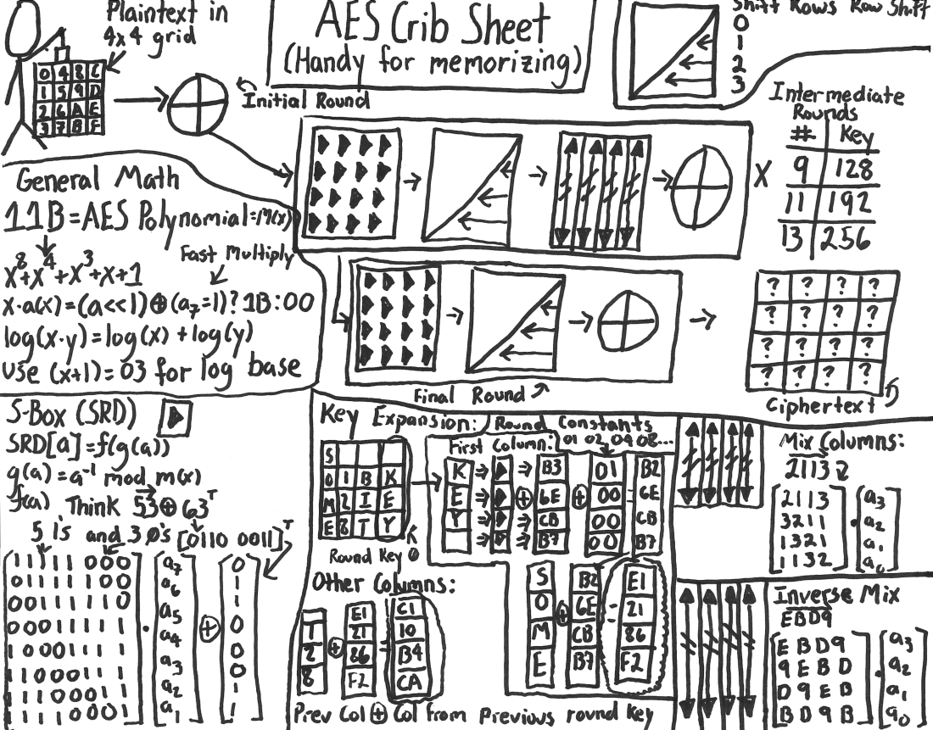
AES Implementation – A Stick Figure’s Guide (Don’t Try This At Home)
http://www.moserware.com/2009/09/stick-figure-guide-to-advanced.html

Slide 20
Activity: DES Death March (15 min)
NIST used a competition model to land on the standard that became AES. Competitions like these are also used to determine which standards we should phase out. RSA Security leveraged a similar model in their DES Challenges, in which cryptanalysts the world over uncovered weaknesses in the Data Encryption Standard (DES), the precursor to AES.
In this activity, you will learn more about this, by reading sections of a text and answering questions based on the text.
Instructions
Open the PDF provided to you, called The Day DES Died
Read the specific sections noted in the worksheet
Answer the questions in the worksheet

Slide 21
DES Death March
Instructor Review

Slide 22
Today’s Goals
By the end of class, you will be able to:
Articulate the goals of cryptography: privacy, authentication, integrity, and non-repudiation.
Discuss modern encryption standards, and in particular AES.
Compare and contrast substitution and transposition ciphers.
Explain how textual data can be represented in binary, octal, and hex.
Determine the output of the XOR operation given two input bitstreams.
Compare and contrast symmetric and asymmetric cryptography.
Use OpenSSL to encrypt data with a symmetric key.
Notes:
Review goals; address any questions.

Slide 23
Ciphers and Keys

Slide 24

The Key Concept in Cryptography
Plaintext
Ciphertext
Encryption
Readable
Message,
File, or Data
Encrypted Message, File, or Data
Key(s)
Decryption
At the center of any conversation on cryptography is the idea of a key, a piece of information or parameter that specifies how plaintext should be transformed into ciphertext and vice versa.

Slide 25
Strength vs Computational Efficiency
Do we want an incredibly strong cipher that's hard to compute and difficult to decrypt?
OR
Do we prefer "average" security that's fast?

Slide 26
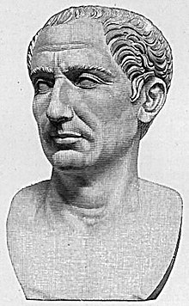
History of Caesar Cipher
They Shall Never Crack My Code!
The Caesar Cipher is one of the best known historic encryption techniques.
It is a simple “substitution cipher” in which messages are letter shifted according to a key.
It’s named after Julius Caesar who is said to have used a shift of three to protect military messages.
Despite it’s age and simplicity, it continues to appear as a blunt method of obfuscation.

Slide 27
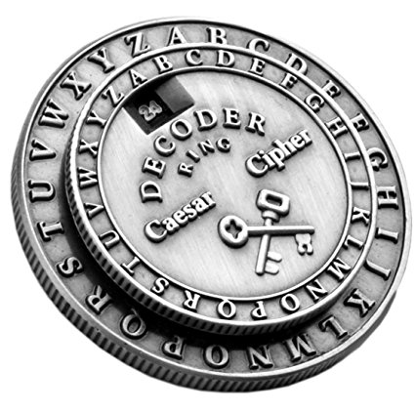
How the Caesar Cipher Works
Sender:
Writes Message
Selects Key
Encodes Message
Receiver:
Receives Message
Uses known key
Decodes Message
Message
Key
Senders select a shift-index (key) and use it to shift their messages (encryption).
Recipients then use the same key to retrieve the original message (decryption).

Slide 28
Caesar At Work (Message Encoding)
Key = 0
Original
A
B
C
D
E
F
G
H
I
J
A
B
C
D
E
F
G
H
I
J
Encoded
How it Works:
The Caesar Cipher works by shifting letters a set number of indices from their original position.
The number of letter shifts is determined by the key value.

Slide 29
Caesar At Work (Message Encoding)
Key = 0
Original
A
B
C
D
E
F
G
H
I
J
A
B
C
D
E
F
G
H
I
J
Encoded
Examples:
“I HID A CAB” → “I HID A CAB”
“A BAD DAD” → “A BAD DAD”

Slide 30
Caesar At Work (Message Encoding)
Key = 2
Original
A
B
C
D
E
F
G
H
I
J
A
B
C
D
E
F
G
H
I
J
Encoded
Examples:
“I HID A CAB” → “K JKF C ECD”
“A BAD DAD” → “C DCF FCF”

Slide 31
Permutation
hello
hlleo

Slide 32
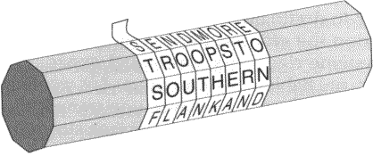
Transposition Cipher
Source
Breaks an input message into equal-sized blocks
Rearranges the letters of each block according to a fixed rule

Slide 33
Transposition Cipher
| 1 2 3 |
E = | |
| 3 1 2 |
Breaks an input into three blocks
Replaces the 1st, 2nd, and 3rd letters of the block with the 3rd, 1st, and 2nd, respectively.
This encrypts the message `hello!` to `lhe!lo`

Slide 34
Activity: Simple Ciphers and Keyspaces (13 min)
In this activity, you will practice using each of the classic ciphers discussed in lecture, and analyze their keyspaces to "rank" them in terms of strength.
Instructions
Answer the questions in the worksheet provided to you

Slide 35
Simple Ciphers and Keyspaces
Instructor Review

Slide 36
Today’s Goals
By the end of class, you will be able to:
Articulate the goals of cryptography: privacy, authentication, integrity, and non-repudiation.
Discuss modern encryption standards, and in particular AES.
Compare and contrast substitution and transposition ciphers.
Explain how textual data can be represented in binary, octal, and hex.
Determine the output of the XOR operation given two input bitstreams.
Compare and contrast symmetric and asymmetric cryptography.
Use OpenSSL to encrypt data with a symmetric key.
Notes:
Review goals; address any questions.

Slide 37
Character Encoding and Binary Representation

Slide 38
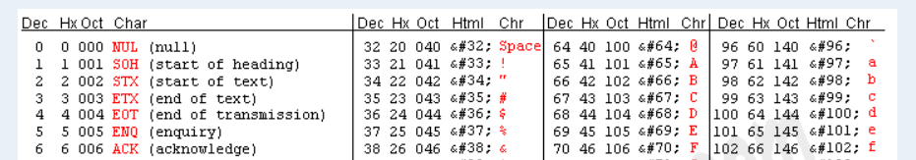
ASCII Encoding
Dec
Chr
Chr Dec Hex Oct
A = 65 = 41 = 101
a = 97 = 61 = 141

Slide 39
Binary
Number in Decimal | This means
10 | 1 ten 0 ones
11 | 1 ten 1 ones
12 | 1 ten 2 ones
100 | 10 tens 0 ones

Slide 40
Binary
Number in Binary | This means | Translated to Decimal
10 | 1 two 0 ones | 2 (1 × 2¹) + (0 × 2⁰)
11 | 1 two 1 one | 3 (1 × 2¹) + (1 × 2⁰)
100 | 2 twos 0 ones | 4 (1 × 2²) + (0 × 2¹) + (0 × 2⁰)

Slide 41
Hexadecimal
Hexadecimal numbers are written with a preceding \x, to indicate the number that follows is in hex format, e.g.: \x10.
a-f are treated as the numbers 11 through 16.
The hex number \x10 is 10 in decimal The hex "number" \xa is 11 in decimal
The hex “number” \xf is 16 in decimal

Slide 42
Hexadecimal
\x10:
"I have one sixteen, and zero ones"
So, \x10 is 16 in decimal
\x16:
"I have one sixteen and six ones"
So, \x16 is 24 in decimal
\x2a:
"I have two sixteens and one eleven",
So, \x2a is 43 in decimal

Slide 43
Octal
Counts in eights instead of sixteens
Octal 042:
"I have four eights and two ones"
So, octal 042 is 34 in decimal

Slide 44
Character Encoding
https://www.rapidtables.com/convert/number/binary-to-hex.html
https://www.branah.com/ascii-converter

Slide 45
Activity: Character Encoding (10 Mins)
In this activity, you will do a scavenger hunt by trying to figure out what is the type of character encoding, and decode it to find the next clue. This will help teach youhow to identify what looks like Binary vs ASCII, vs hex and other formats, as well as how to use web tools to convert.
Instructions
Convert the following into binary code:
57 65 6c 63 6f 6d 65 20 74 6f 20 74 68 65 20 73 63 61 76 65 6e 67 65 72 20 68 75 6e 74 21 20 47 6f 20 74 6f 20 74 68 65 20 66 6f 6c 6c 6f 77 69 6e 67 20 77 65 62 73 69 74 65 3a 0a 68 74 74 70 3a 2f 2f 77 77 77 2e 70 61 67 65 6f 72 61 6d 61 2e 63 6f 6d 2f 3f 70 3d 73 65 63 72 65 74 34
Hint: Copy and paste the above into Google and this should give you a list of results that will convert this code for you

Slide 46
Character Encoding
Instructor Review

Slide 47
Today’s Goals
By the end of class, you will be able to:
Articulate the goals of cryptography: privacy, authentication, integrity, and non-repudiation.
Discuss modern encryption standards, and in particular AES.
Compare and contrast substitution and transposition ciphers.
Explain how textual data can be represented in binary, octal, and hex.
Determine the output of the XOR operation given two input bitstreams.
Compare and contrast symmetric and asymmetric cryptography.
Use OpenSSL to encrypt data with a symmetric key.
Notes:
Review goals; address any questions.

Slide 48
Bitwise Operators and XOR Cipher

Slide 49
Bits and Bytes
1101000
Bit
Group of 8 bits = Byte

Slide 50
Bitwise Operator
X | Y | X & Y | X | Y | X^Y (XOR)
1 | 1 | 1 | 1 | 0
0 | 0 | 0 | 0 | 0
0 | 1 | 0 | 1 | 1
1 | 0 | 0 | 1 | 1

Slide 51
Bitwise Operator
X | Y | X & Y | X | Y | X^Y
1100 | 0110 | 0100 | 1110 | 1010

Slide 52
XOR is Reversible
X | Y | X^Y
1100 | 0110 | 1010
1010 | 0110 | 1100
A ^ B = C C ^ B = A
We can encrypt a number, A, by using a key, B, to
produce the encoded data in C
We can decrypt C by XOR-ing it with the key, B,
to retrieve the plaintext, A

Slide 53
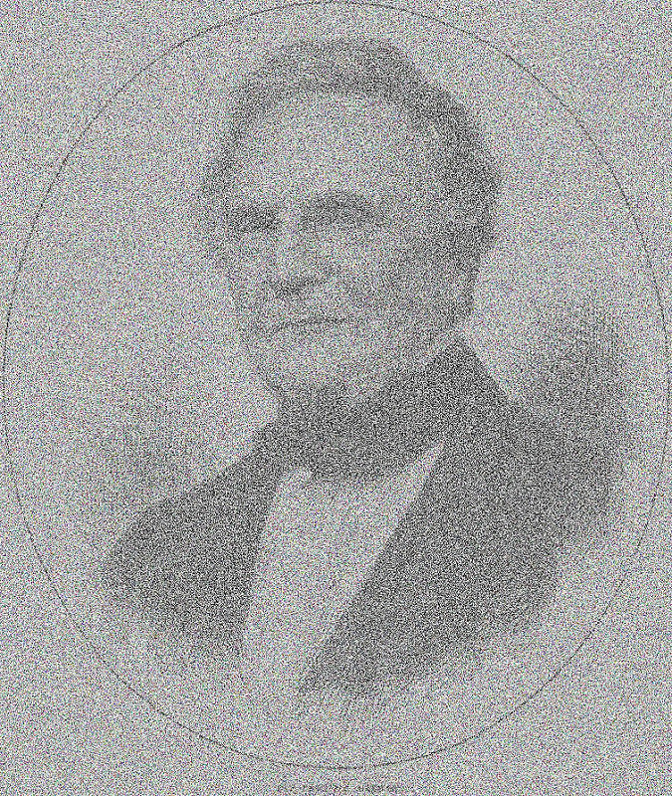
Image Encrypted with AND
Source

Slide 54
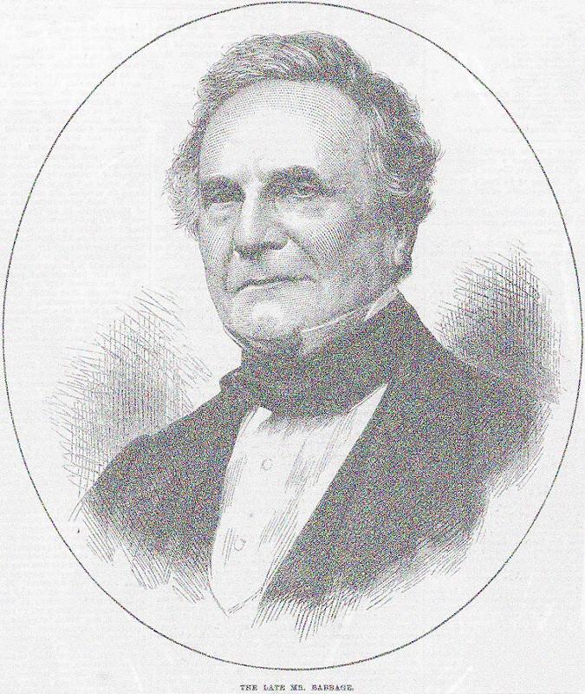
Image Encrypted with OR
Source

Slide 55

Image Encrypted with XOR
Source

Slide 56
Activity: XOR Cipher (7 Mins)
In this activity, you will:
Develop an intuition for the behavior of XOR
Build "truth tables" for AND, OR, and XOR
Instructions:
Complete the three section of the worksheet
XOR Practice
Truth Tables
Questions

Slide 57
XOR Cipher
Instructor Review

Slide 58
Today’s Goals
By the end of class, you will be able to:
Articulate the goals of cryptography: privacy, authentication, integrity, and non-repudiation.
Discuss modern encryption standards, and in particular AES.
Compare and contrast substitution and transposition ciphers.
Explain how textual data can be represented in binary, octal, and hex.
Determine the output of the XOR operation given two input bitstreams.
Compare and contrast symmetric and asymmetric cryptography.
Use OpenSSL to encrypt data with a symmetric key.
Notes:
Review goals; address any questions.

Slide 59
Symmetric vs. Asymmetric Cryptography

Slide 60
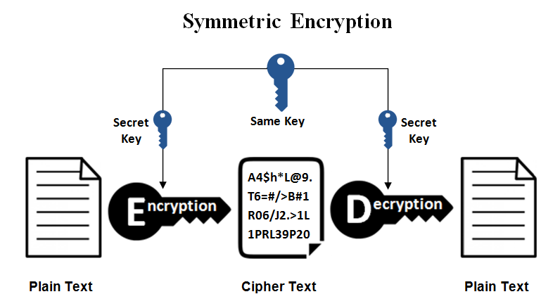
Symmetric Encryption

Slide 61
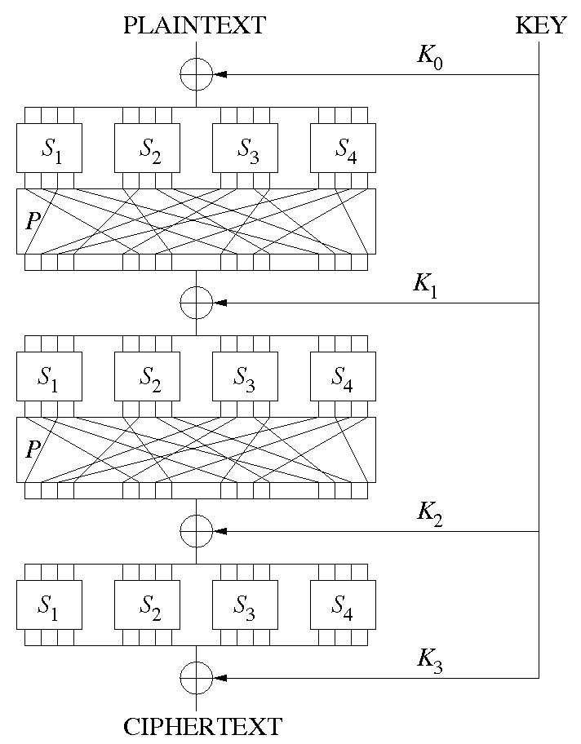
Symmetric Encryption
* Divide data into blocks (as in transposition)
* Perform a substitution on each block
* Perform a permutation of the resulting substitution
* The key is XOR'ed with the resulting permutation

Slide 62
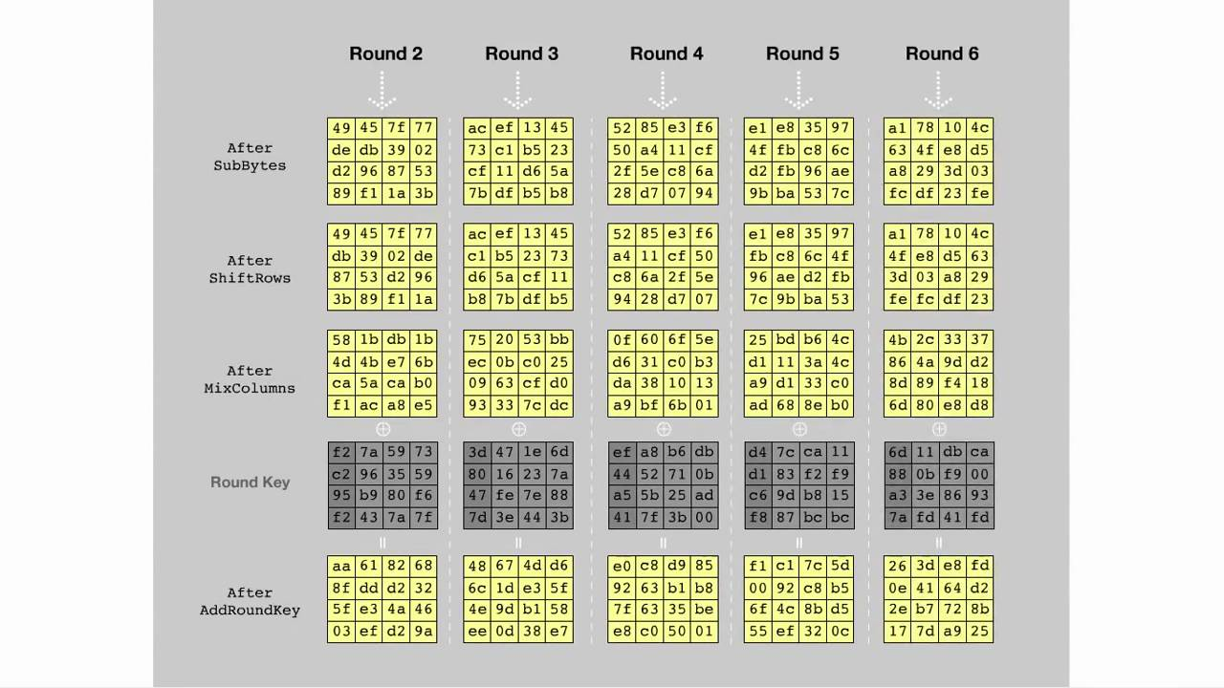
Symmetric Encryption

Slide 63
Key Exchange
One key is required for every pair of people which wants to share encrypted messages
Alice, Bob, Eve, and Jane
Alice <> Bob
Alice <> Eve
Alice <> Jane
Bob <> Eve
Bob <> Jane
Jane <> Eve
Six different keys are required!

Slide 64
Asymmetric Cryptography
This key exchange problem motivates a model that uses two keys instead of one.
This "two key" model is known as asymmetric cryptography, or public-key cryptography.

Slide 65
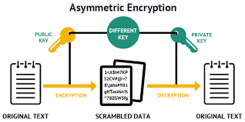
Asymmetric Cryptography

Slide 66
Symmetric Algorithms
Faster
Less computationally intense
Pose challenges due to the key-exchange problem
The de facto standard symmetric algorithm is AES, the Advanced Encryption Standard

Slide 67
Asymmetric Algorithms
More computationally intense
Don't have a key-exchange problem
Easier to use with many people
Used to verify identity/authenticity via digital signatures
Symmetric algorithms cannot do this
The de facto standard asymmetric algorithm is RSA, the Rivest-Shamir-Adleman algorithm

Slide 68
Today’s Goals
By the end of class, you will be able to:
Articulate the goals of cryptography: privacy, authentication, integrity, and non-repudiation.
Discuss modern encryption standards, and in particular AES.
Compare and contrast substitution and transposition ciphers.
Explain how textual data can be represented in binary, octal, and hex.
Determine the output of the XOR operation given two input bitstreams.
Compare and contrast symmetric and asymmetric cryptography.
Use OpenSSL to encrypt data with a symmetric key.
Notes:
Review goals; address any questions.

Slide 69
Encrypting Data with OpenSSL

Slide 70
Encrypting with SSL
openssl enc -aes-256-cbc -in input_file -out encrypted_output
openssl: the `openssl` program
enc: encrypt
-aes-256-cbc: the cipher to use
-in: the file to encrypt
-out: the file to save the encrypted output to
Notes:
Review goals; address any questions.

Slide 71
Decrypting with SSL
openssl enc -aes-256-cbc -d -in encrypted_output -pass pass:hello
-d: decrypt
-in: the encrypted file to decrypt
-pass pass:<password>: the password to use to decrypt.
Notes:
Review goals; address any questions.

Slide 72
Activity: Symmetric Encryption with OpenSSL (10 min)
In this activity you will use the command-line tool OpenSSL to encrypt data with the AES symmetric cipher.
Instructions
Follow the steps in the worksheet to generate your key and IV, encrypt, and decrypt your messages.
Send your partner an encrypted message, your key, and your IV. Verify that they're able to decrypt the message.
Answer the questions in the worksheet

Slide 73
Symmetric Encryption with OpenSSL
Instructor Review

Slide 74
Today’s Goals
By the end of class, you will be able to:
Articulate the goals of cryptography: privacy, authentication, integrity, and non-repudiation.
Discuss modern encryption standards, and in particular AES.
Compare and contrast substitution and transposition ciphers.
Explain how textual data can be represented in binary, octal, and hex.
Determine the output of the XOR operation given two input bitstreams.
Compare and contrast symmetric and asymmetric cryptography.
Use OpenSSL to encrypt data with a symmetric key.
Notes:
Review goals; address any questions.

